Slide 1
reimagine
accelerate
begin

Slide 2
Embedded analytics with Power BI
TECH-BAAI307
Lukasz Pawlowski
Senior Program Manager
TECH-BAAI307

Slide 3
Confidentiality slide

Slide 4
Session objectives and takeaways
At the end of this session, you should be better able to…
Understand how “Embedded Analytics” with Power BI
enables ISVs and Enterprise developers to do more
Get up to speed on all the June ‘17 announcements
We’re ready for prime time
Your opportunity can get bigger with Embedded Analytics

Slide 5

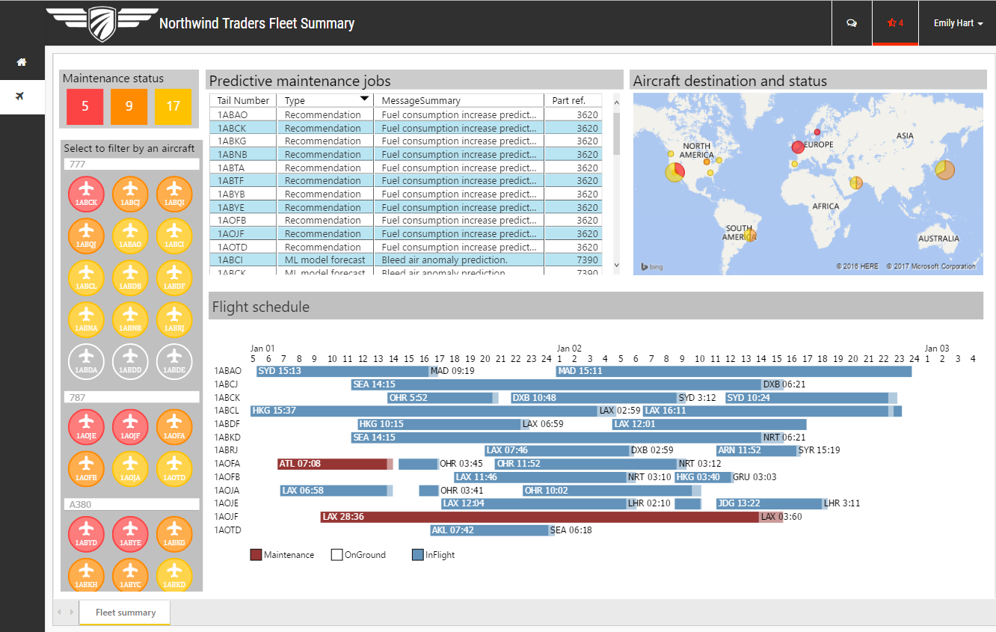
Nearly everyone engages with apps
Yet fewer than 22% of employees have access to analytical insights
http://biscorecard.typepad.com/biscorecard/bi-strategies//

Slide 6
Many apps have reporting capabilities
Providing contextual insights where and when users need them is challenging
010001001010 110101010010 101011010101
Dispersed and complex data
Device-agnostic consumption
Shrinking attention spans

Slide 7

What if your app could put the power of analytics everywhere decisions are made?
Modern apps with data visualization built-in have the power to inform decisions in context— for any user, on any device

Slide 8
Power BI for embedded analytics Apps energized with analytics
DATA
INSIGHTS
ACTION
Get started quickly
Live Reports & Dashboards
Cloud
Natural Language Query
Apps
Custom Visualizations
Power BI
On-premises
Open & extensible

Slide 9

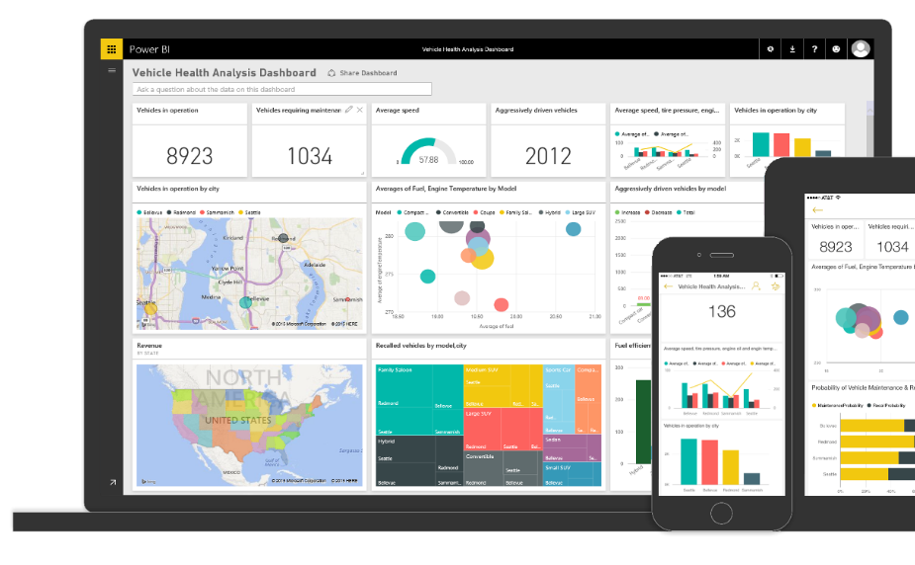
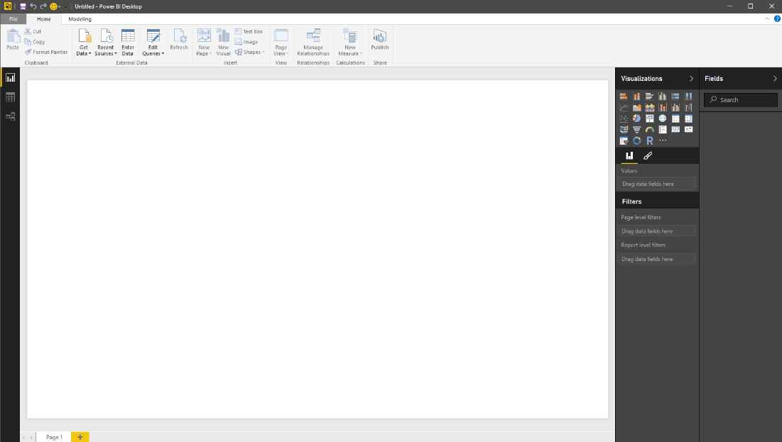
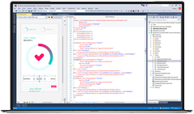
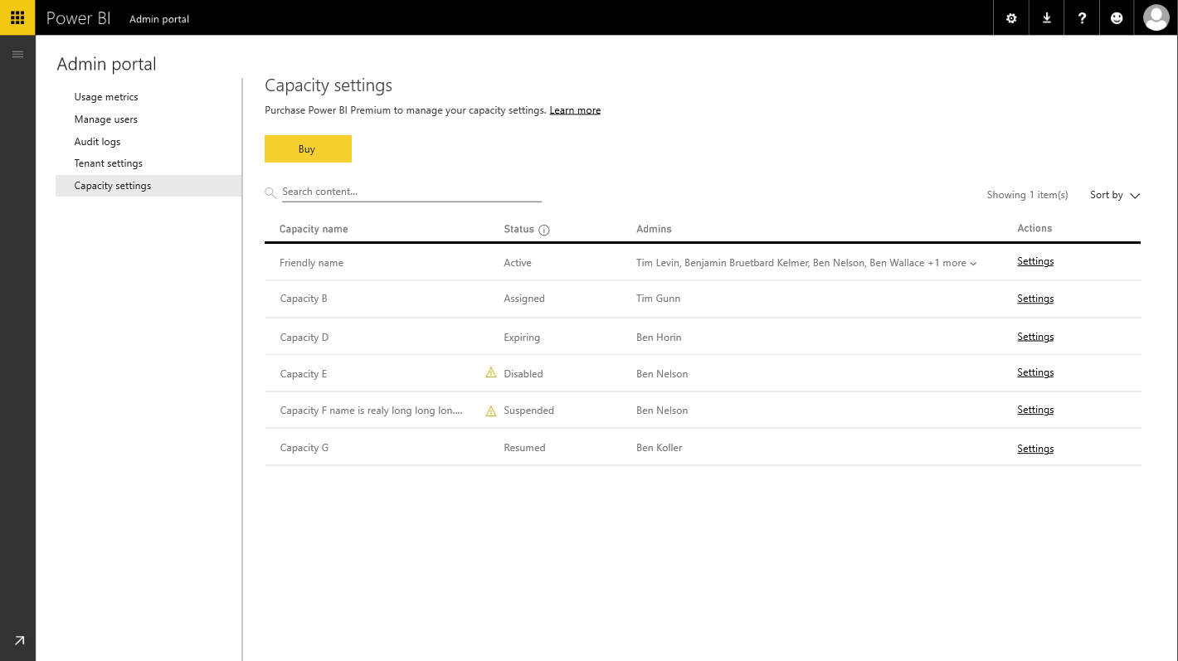
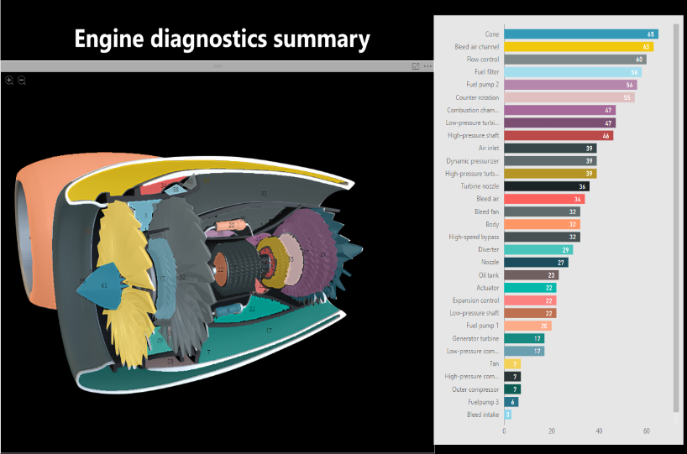
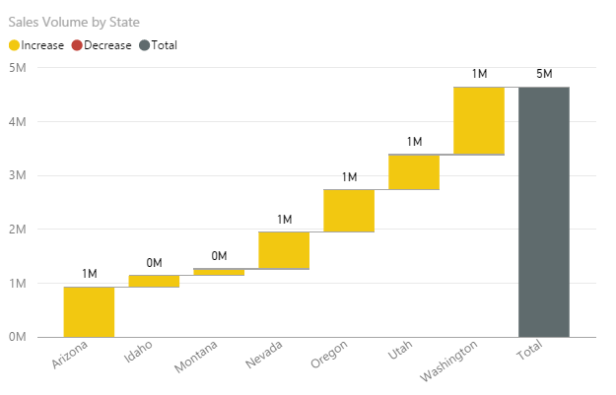
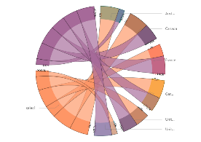

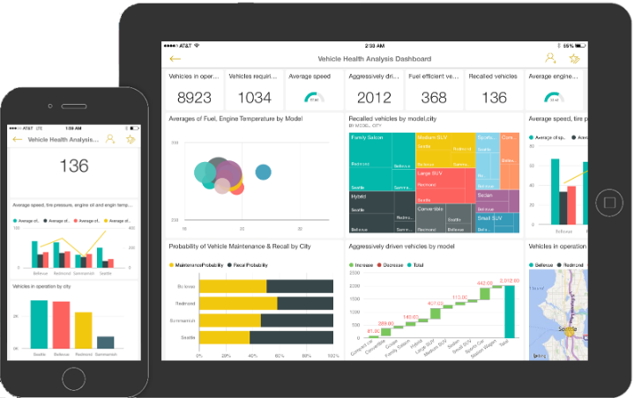
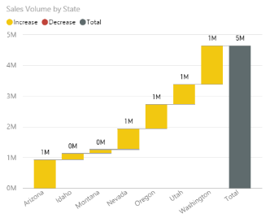

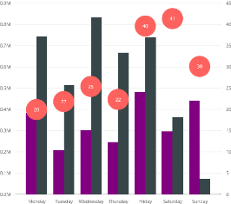
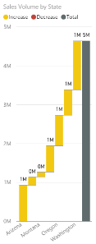
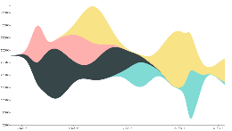
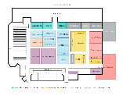


Bring data to life inside your app The ISV organization
Analyst
Developer
Power BI tenant admin
Developer
Create compelling interactive reports
Provision efficiently without losing your app context
&
Manage your application tenants with ease
Embed easily for faster time to value

Slide 10
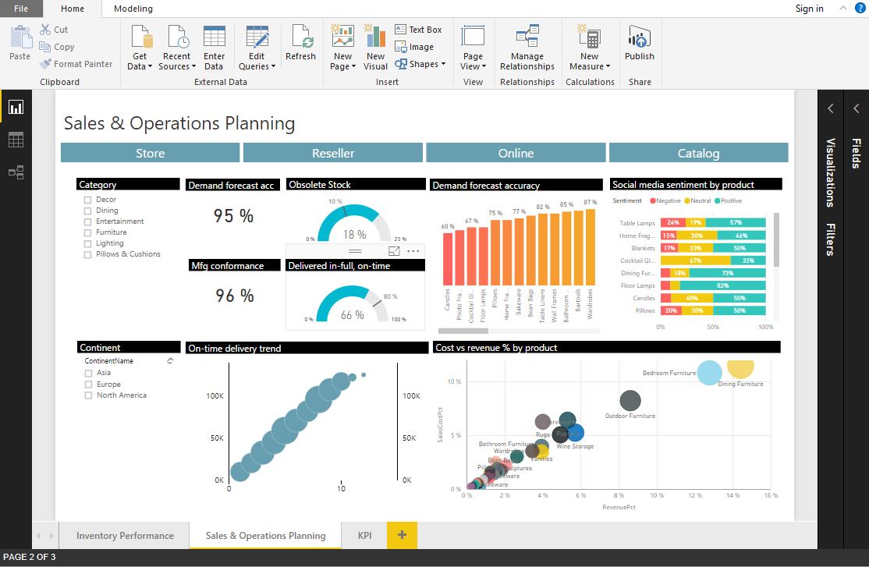
Easily create interactive reports for free in Power BI Desktop
Shape data into the format and structure you need
Produce rich data models using formulas and relationships
Explore data through a freeform, drag-and-drop canvas
Publish interactive visualizations to your app
Analyst
Developer
BI Admin

Slide 11





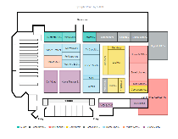
The right visualization for your app with Custom Visuals
ISV’s apps are better when showing data tailored to the needs of the app’s users
Any visualization you can imagine not limited to “what’s-in-the-box”
Download visuals from the Power BI community-authored visuals gallery and Office store
Analyst
Developer
BI Admin

Slide 12

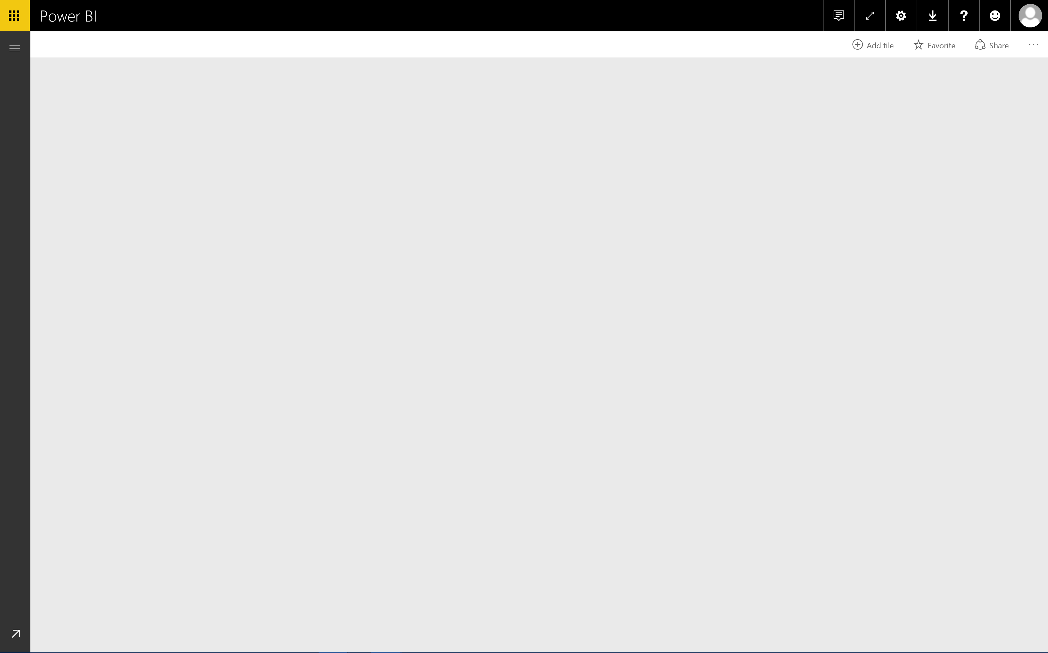
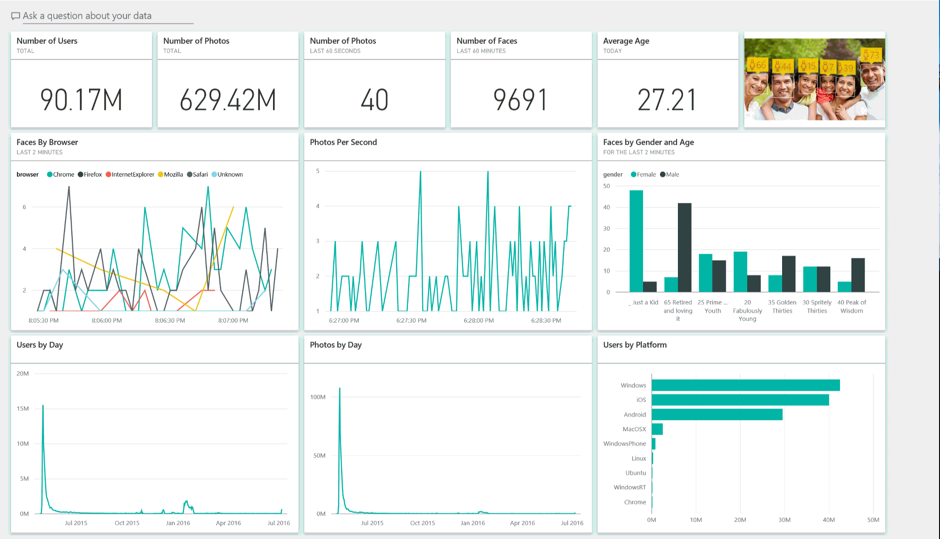
Keep the data in your app up to date
Connect to data using Direct Query
for cloud and on-premises data sources
Create cached data models with
scheduled and programmatic refresh
Track your data in real-time with support for streaming data
Analyst
Developer
BI Admin

Slide 13
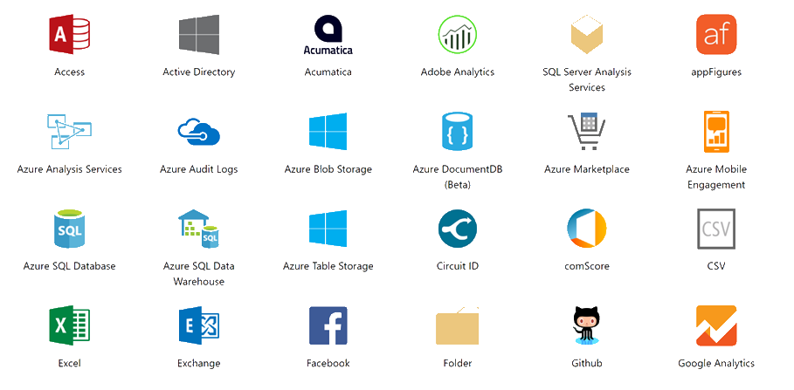
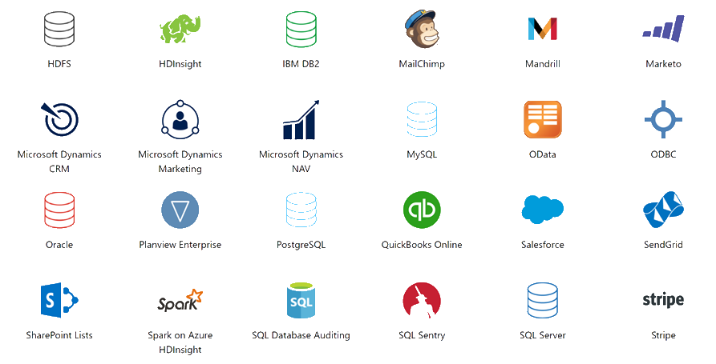
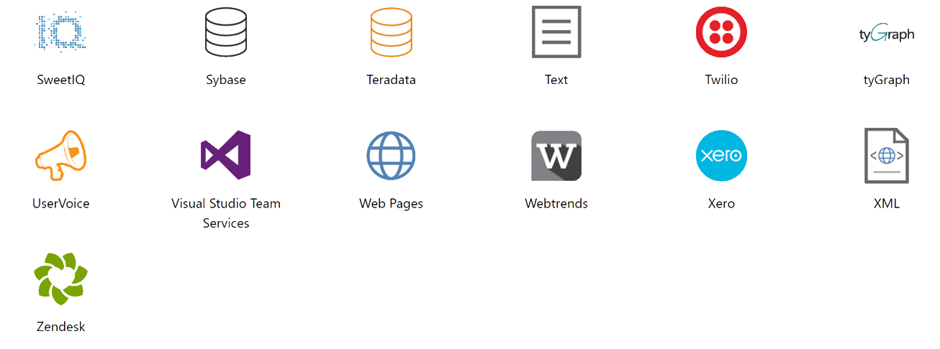
What data sources can I connect to?
Same as PowerBI.com
More are added every day
Analyst
Developer
BI Admin

Slide 14
Provision automatically and deploy at scale
Dedicated
resources
in the cloud
Greater scale and performance
Automate provisioning with Power BI APIs
Easily deploy your solution topology and ‘Golden’ report directory with Workspace API automation
Fully automate the new customer on boarding flow with clone and rebind API automation
Predictable pricing with Power BI Premium dedicated capacity
Power BI Premium
Flexibility to license by capacity
Analyst
Developer
BI Admin

Slide 15

Embed reports easily—for any device and faster time-to-value
Easily embed interactive reports and dashboards in your app using REST APIs and the Power BI SDK
Make intelligent actions the norm with the bidirectional JavaScript API
Provide friction-free authentication and authorization experiences with Embed Tokens
Analyst
Developer
BI Admin

Slide 16
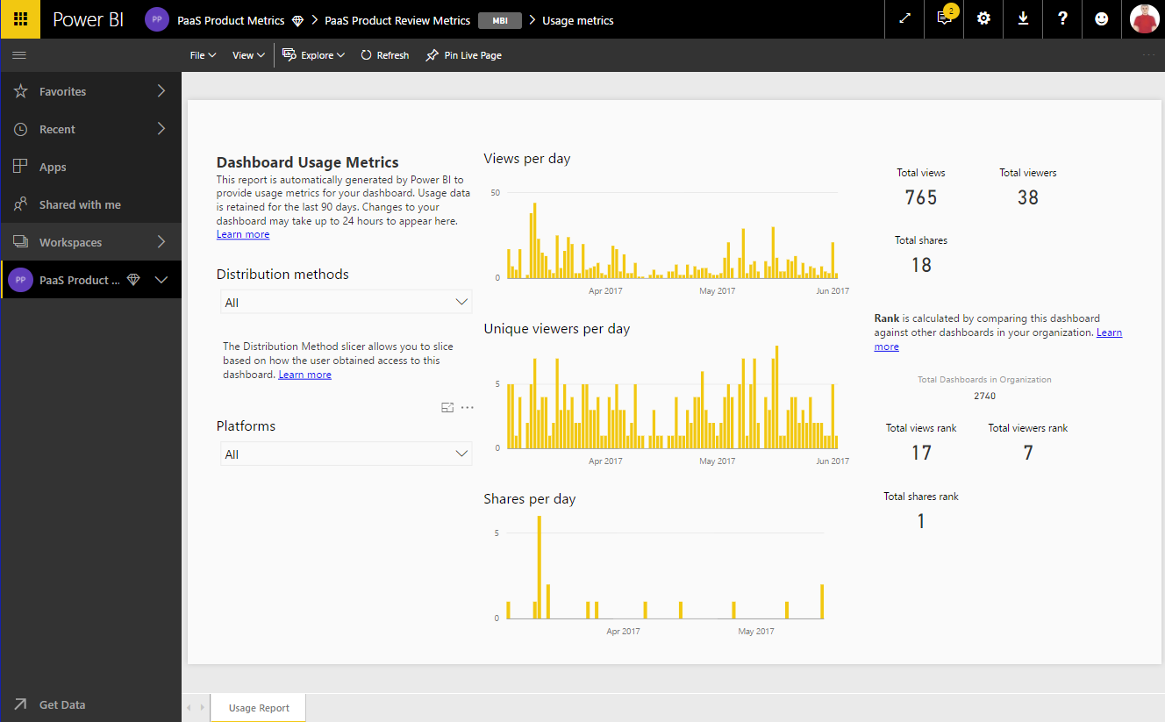
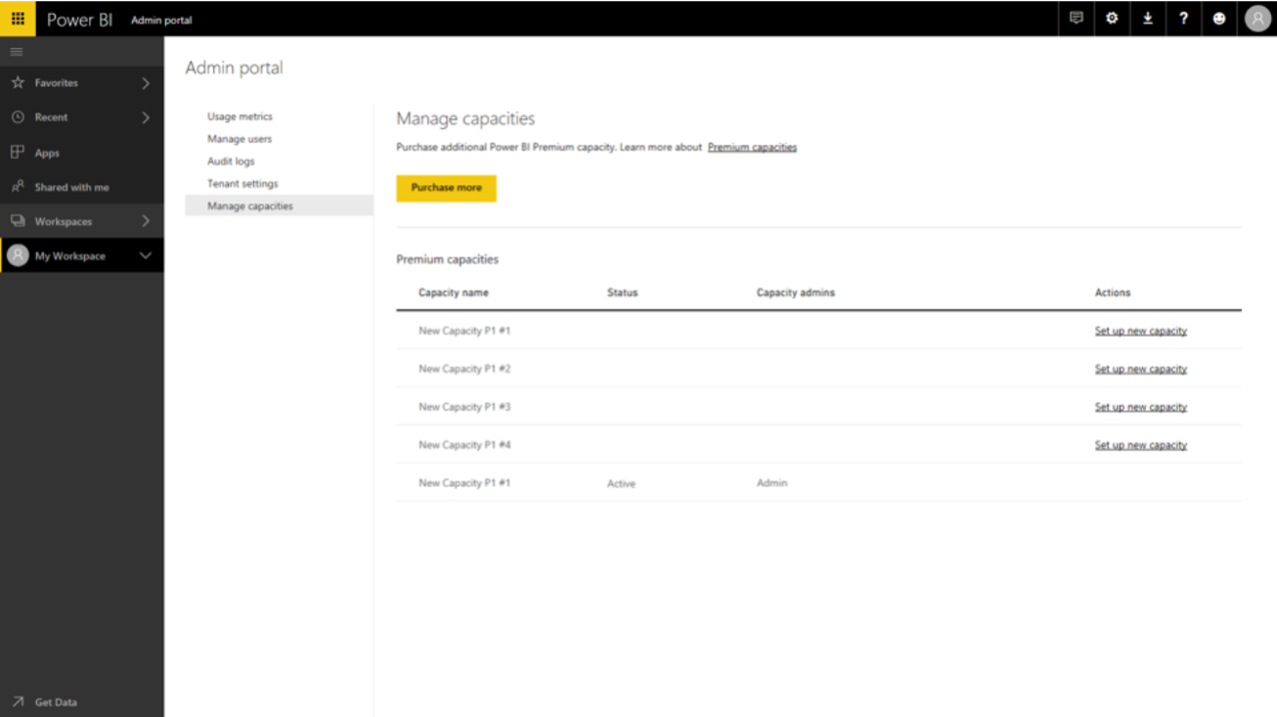
Manage tenant level and capacity usage through Power BI portal
Set granular tenant level settings for your app tenant through the Power BI Admin portal
Assign your customers to the select Power BI Premium capacity
Monitor your customers report activity with Usage Metrics for Dashboard and Report
Analyst
Developer
BI Admin

Slide 17

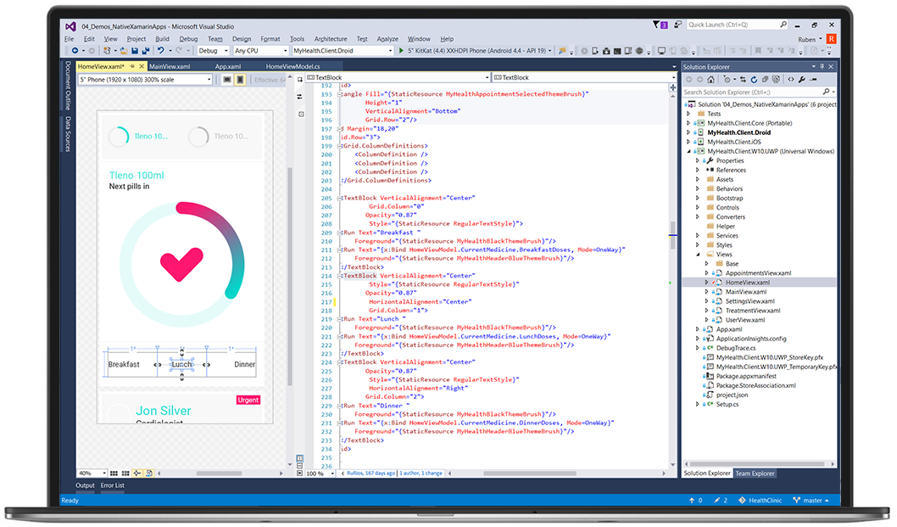
Bring data to life inside your app The ISV customer
Analyst
Business user
Create compelling interactive reports
Consume KPIs, reports

Slide 18
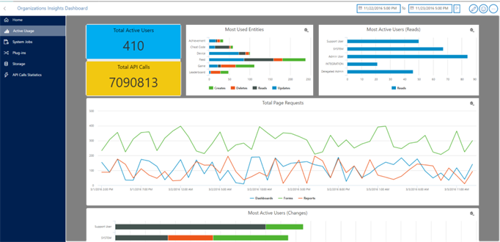
Enable app end users to consume and create reports with a single consistent API
Embed reports for External use, through SaaS applications or external portals
Embed reports for Internal use, through Line of Business applications or SharePoint online
Enable full self service capabilities inside your app, create new reports, edit and personalize reports

Slide 19
Demo: ISV application sample
Simple Demo:
https://dev.powerbi.com
click “See Power Bi In An App”
Complete Demo:
Get instructions on
https://aka.ms/bi
Click on “embedded”
Expand “Technical Resources”
Click “Power BI Embedded - Airline Demo script”

Slide 20
Advanced topics
Power BI Embedded setup flow
Report access with Embed Token
Row-level security (RLS)
API surface

Slide 21
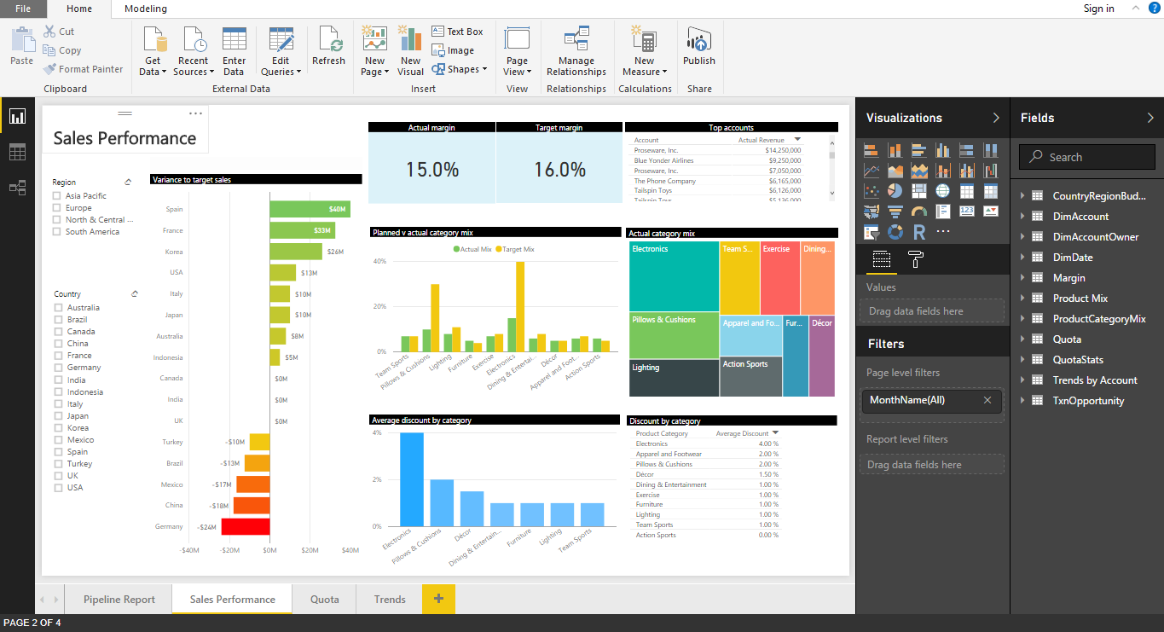













Power BI embedded setup flow
Create
Provision
Embed
1,N
Microsoft Azure subscription
1,N
Developer
AAD Tenant
Analyst
Name
End users
Admin Users
MICROSOFT CLOUD
Endpoints
Credentials
Geo Location
Purchase
1,N
NON-MICROSOFT CLOUD
AAD User
Power BI Pro
Power BI Premium
Name
Credentials
1,N
Power BI Desktop
ON-PREMISE DATA
Power BI Group
Name
Reports
Your app
Datasets

Slide 22
Getting started step by step
Sign up for Power BI & determine what tenant setup to use:
Use your corporate Power BI tenant?
Use a separate tenant for your application?
Use a separate tenant for each customer?
Create a user for the service to service commutation (and assign a Pro license)
Create a workspace for development
Start the dev work..
Get a premium SKU for your production environment.
Create a workspace for production and assign it to the capacity model
Move content over to production tenant
Switch user if you want to separate the users between dev and prod
Go to production

Slide 23
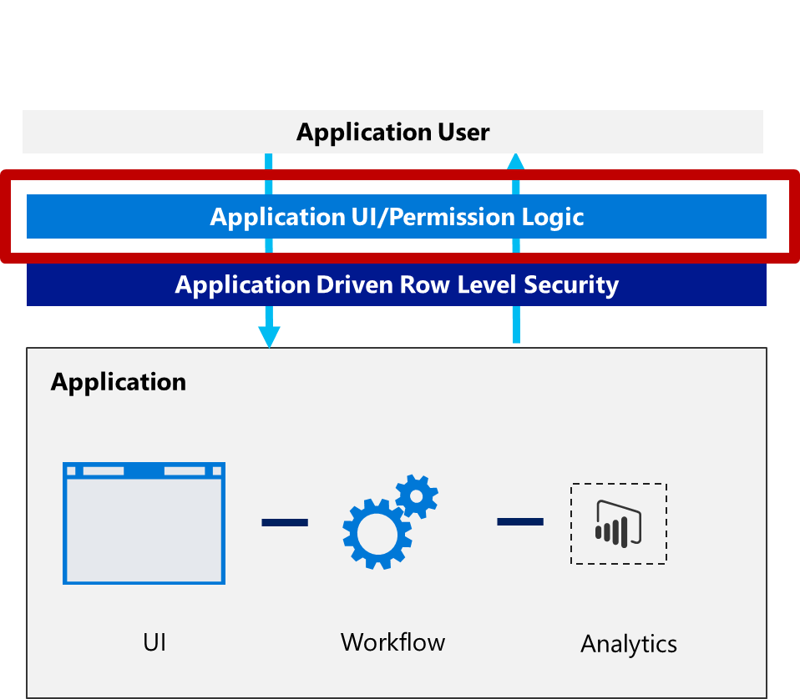
Provision
Upload a report to Power BI
Publish directly form Power BI Desktop or
Call Import API
Set dataset connection strings
Call Default.SetAllConnections API
Provision a new customer with report clone/rebind

Slide 24
Embed
Your application authenticates users
You own and manage users
You own and manage user permissions
Your application issues tokens that authorize access to Power BI reports
Tokens are bearer tokens
The token your application issues determines:
Which visualization can be accessed
How long it can be accessed for
What data can be seen by the user
What is the user allowed to do on the embedded report

Slide 25
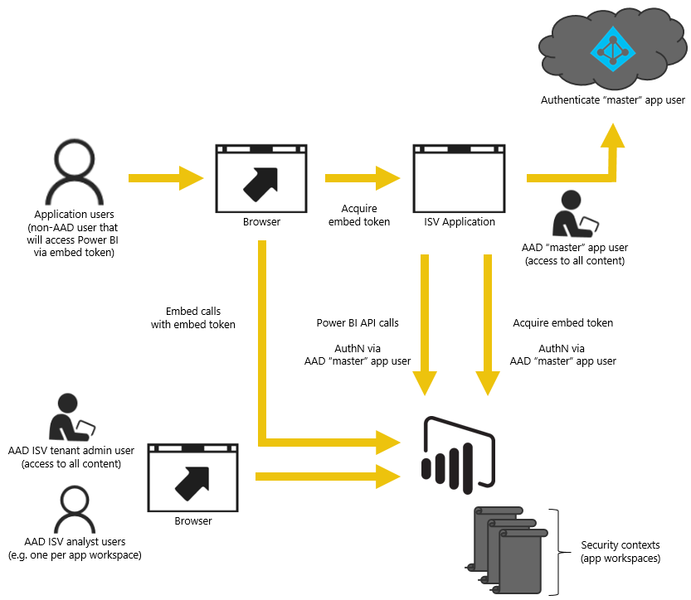
Token Authentication Explained

Slide 26
Row-level security
Report
+
Token
=
Query + Predicate
Defines Roles
Roles define predicates
Role: Company
Predicate: [Company] = “Fabrikam”
Role: Company
Predicate: [Company] = USERNAME()
Asserts Role Membership
Asserts Identity
roles: “Fabrikam”
roles: “Company”
username: “Fabrikam”
Query executes with correct scope
Select * FROM [Sales] WHERE [Company] = “Fabrikam”
SELECT * FROM [Sales] WHERE [Company] = “Fabrikam”
Ex.1
*
Ex. 2
* Dynamic RLS will be available only in August

Slide 27
Demo Power BI Embedded Tutorial
Microsoft Power BI – Report Embed Sample
https://github.com/Microsoft/PowerBI-Developer-Samples

Slide 28
The Power BI Embedded API surface
Power BI JavaScript API
Provides bidirectional communication between Power BI reports and your app
Enables easier integration of reports and reporting functionality
Enables programmatic interaction
Embed a specific report
Page navigation
Load a default report page
Edit or Create reports
Enable/disable the filter pane
Filter reports
React to events, including print and reload
Handle data selection events
Embed dashboard

Slide 29
The Power BI Embedded API surface
Power BI REST API
Enable full automation of the provisioning flow
Programmatically keep your data fresh at all times
Import
Get reports
Set data source connections
Report clone/bind
Get dashboards
Refresh dataset
CRUD workspaces
Get dashboard tiles
EGW APIs

Slide 30
Deployment options single WS/report/dataset with RLS
Application User
Application UI/Permission Logic
Application Driven Row Level Security
Power BI Tenant (AAD)
Suitable for smaller deployments
Reports are standardized across customers, so app just uploads a copy of the report at provisioning time
Database schemas are identical, chosen to stay under Azure SQL size limits
Azure SQL maximum storage per database is 1TB (current P15 SKU)
PBI Workspace 1
Report 1 with RLS
Azure SQL for all tenants
ETL
Storage
Blob
Table Storage
Data Lake
Others…

Slide 31
Deployment options multi WS/report/dataset with RLS
Application User
Application UI/Permission Logic
Application Driven Row Level Security
PBI Tenant (AAD)
Isolates tenant data physically
Isolates user data within tenant with RLS
Uses groups and/or AAD tenants for isolation
Application logic routes users to their reporting resources
PBI workspace 1
PBI Workspace N
Copy of Report 1 with RLS
Copy of Report 1 with RLS
Azure SQL for Tenant 1
Azure SQL for Tenant N
ETL
Storage
Blob
Table Storage
Data Lake
Others…

Slide 32

Deployment options multi region
Application User
Application UI/Permission Logic
Application Driven Row Level Security
Supports global user base with region-specific compute and storage
Addresses regions that have law/compliance considerations
PBI Tenant (AAD) for
USA customers
PBI Tenant (AAD) for
European customers

Slide 33
Licensing & pricing
Minimum licensing requirements
Premium capacity costs and sizing

Slide 34
Minimum licensing requirements
POWER BI DESKTOP
Authoring & Exploration
Free
POWER BI PRO
Admin | Content publishing | Development
$9.99/user/month*
POWER BI PREMIUM
Testing | Deployment
Starting at $625
* Power BI Pro available through 2-month trial and included in MSDN subscription benefits

Slide 35
Estimate Capacity Needs for ISVs
POWER BI PREMIUM
Testing | Deployment
Node | Virtual cores | Deployment option | Price per month¹ | Max page renders at peak hour | 2017 availability
Power BI Premium EM1² | 1 | PaaS | $625 | 1-300 | July
Power BI Premium EM2² | 2 | PaaS | $1,245 | 301-600 | July
Power BI Premium EM3² | 4 | PaaS | $2,495 | 601-1,200 | June/July³
Power BI Premium P1 | 8 | PaaS & SaaS | $4,995 | 1,201-2,400 | June
Power BI Premium P2 | 16 | PaaS & SaaS | $9,995 | 2,401-4,800 | June
Power BI Premium P3 | 32 | PaaS & SaaS | $19,995 | 4,801-9,600 | June
Embed only
1. Yearly commitment
2. Only allows consumption through embedded APIs and controls. Power BI Report Server not included.
3. Enterprise Agreement: June 1
Web Direct: June 12
CSP: July 10
Preliminary information. Microsoft makes no warranties, express or implied.

Slide 36
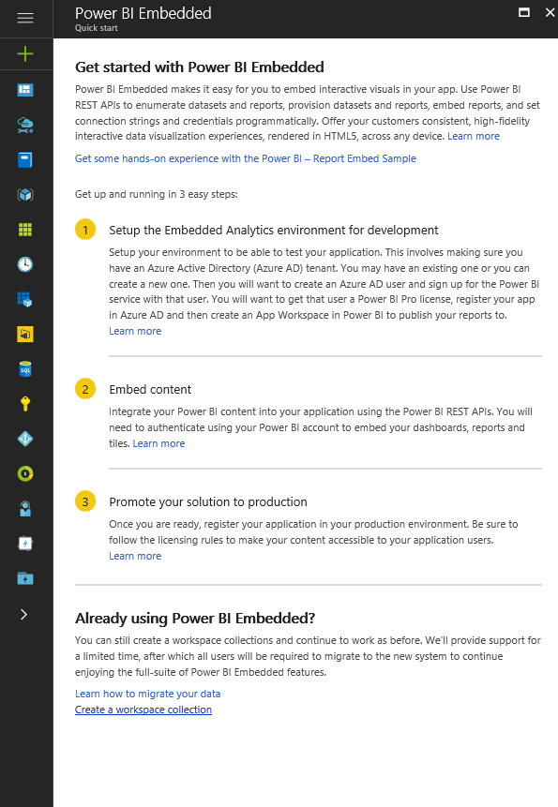
Existing PBIE customers
Updated Azure experience
Migration
Transition timeline

Slide 37
Easily migrate to Power BI
Phase 1
Phase 2
Phase 3
Phase 4
Migration setup in Azure and Office portal
Content creation in Power BI
Adapt the App to Power BI APIs
Azure cleanup
Export all reports
Export the deployment topology
Purchase Power BI Pro license for developer(s)
Rebuild the deployment topology using Power BI groups
Import all reports
Migrate your application to the new Power BI APIs
When ready to move to production, migrate workspaces to the Power BI Premium dedicated capacity
When ready, delete all Power BI Embedded content
MIGRATION RESOURCES
+ Supporting tools and APIs as building blocks to create an automated process
+ Samples for the canonical deployment to help you get started

Slide 38
Power BI Embedded Transition Timeline
Power BI Premium GA Date
EA
Power BI Embedded
Existing service available through end of agreement*
Direct +CSP
Power BI Embedded
Existing service available for up to one year from Power BI Premium GA announcement
*Applies only to EA customers using Power BI Embedded as of GA date. Customers not using Power BI Embedded as of the GA date will need to purchase Power BI Premium (i.e. will not be able to purchase new Power BI Embedded under existing licensing model)

Slide 39
What's coming next 3-6 months
DATA CONNECTIVITY | SetAllConnections for all data sources | Dynamic RLS (non-AS Azure)
EMBED EVERYWHERE | Sovereign clouds (all including new clouds DOD, FBI) | Mobile support* – mobile layout, page navigation and Focus mode
AUTOMATION APIs | Clone dashboards and tiles - shallow copy and update (without dataset cloning) | Capacity automation – assign/un-assign WS, list capacities, list WSs, capacity monitor status Export to PBIX
APP INTERACTIVITY & CAPABILITIES | Report Config Parameters - fit to width, control background color, set report locale on load | Right click gestures Customized error responses
LICENSING AND PURCHASING | Premium P1 SKU monthly subscription
High level planning for next half year

Slide 40
How are ISVs using PBIE today
Monitor main business KPIs
A separate tab for reporting in the Application

Slide 41
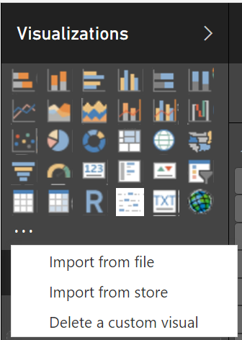
Quick updates for Developers
Custom Visuals are now in the Office Store
Store.office.com
Seamless import and discovery for visuals
SharePoint web part is available to all O365 customers as a preview
Works on Modern Site pages

Slide 42
Developer resources
Developer center
https://powerbi.microsoft.com/en-us/power-bi-embedded/
Developer docs
https://powerbi.microsoft.com/en-us/documentation/powerbi-developer-embedding/
Samples
https://github.com/microsoft/powerbi-developer-samples
Live JS Sample
https://microsoft.github.io/PowerBI-JavaScript/demo/v2-demo/index.html
Visuals gallery
https://store.office.com/en-us/appshome.aspx?productgroup=PowerBI
Ask us questions
http://stackoverflow.com/questions/tagged/powerbi

Slide 43
Session resources
https://aka.ms/bi
then click ‘Embedded’
Accelerator
https://info.microsoft.com/power-bi-embedded-accelerator-offer-register.html
https://Dev.powerbi.com
Internal questions
Business Intelligence Champs bichamps@microsoft.com
ASK General Power BI questions, Roadmap, etc.
WW Communities - Business Analytics wwcombim@microsoft.com
ASK General Power BI questions, Roadmap, etc.
Power BI Embedded Customer Issues pbieci@microsoft.com
ASK Specific Power BI embedded analytics technical questions (APIs, Provisioning, etc.)
Microsoft Ready content can be found at https://digital.microsoftready.com/

Slide 44



Power BI Customer Advisory Team (C.A.T.) | One Slide
GET the CATBot!
BDM Showcase
We own demo resources for CxO-level conversations
Patterns & Practices
We curate content on cross-cutting technology topics
Sales Community Support
We support technical escalations & training opportunities
Engineering Feedback
We influence the products roadmap through engineering feedback rhythms
We engage with
strategic Power BI customers and
the sales professionals supporting them to
showcase and provide technical guidance ,
help drive product adoption and consumption
and influence our engineering
roadmap.
“
”
Call to action: Join the conversation on PBICAT @ Teams

Slide 45
Related content
Breakout Sessions
TECH-BAAI209 - What’s New and What’s Coming in Power BI Desktop
TECH-BAAI301 - Analytics for every need with Power BI
TECH-BAAI302 - Enterprise Power BI Deployments with Power BI Solution Templates
TECH-BAAI304 - Power BI Report Server: Self-service BI and enterprise reporting on-premises
Instructor-led Labs
TECH-BAAI-ILL201 - Getting Started with Power BI for Embedded Analytics
TECH-BAAI-ILL200 - Exploring Power BI Reports in Power BI Report Server
TECH-BAAI-ILL202 - Sharing Power BI content
Hands-on Labs
TECH-BAAI-HOL200 - Creating a Power BI Desktop Solution
TECH-BAAI-HOL201 - Creating a Real-Time Dashboard with the Power BI REST API
TECH-BAAI-HOL202 - Creating and Exploring a Power BI Dashboard
TECH-BAAI-HOL213 - Power BI Reporting From an On-Premises Analysis Services Tabular Database
TECH-BAAI-HOL214 - Power BI Reporting From an On-Premises SQL Server Database
Digital Ready Talks
TECH-BAAI-RT301 - Power BI for the Enterprise
Competitive Content
TECH-BAAI200 - How to compete and win in the crowded BI space with Power BI

Slide 46

Enjoy a session
Fill out an eval
Win a prize
Make MS Ready better
Evaluations can be submitted via
Laptop/Mobile connect to Schedule Builder on www.microsoftready.com
Windows/Windows Phone MS Ready App (Search “MS Ready” in the Store)
Your Mobile Device scan the QR code to reach your evals
*If you plan to remain in this room for the next session, please be sure to scan your badge again at the door prior to the session starting

Slide 47
Q&A
If you have questions please proceed to the Q&A MICROPHONE located in your session room.

